Slide 1
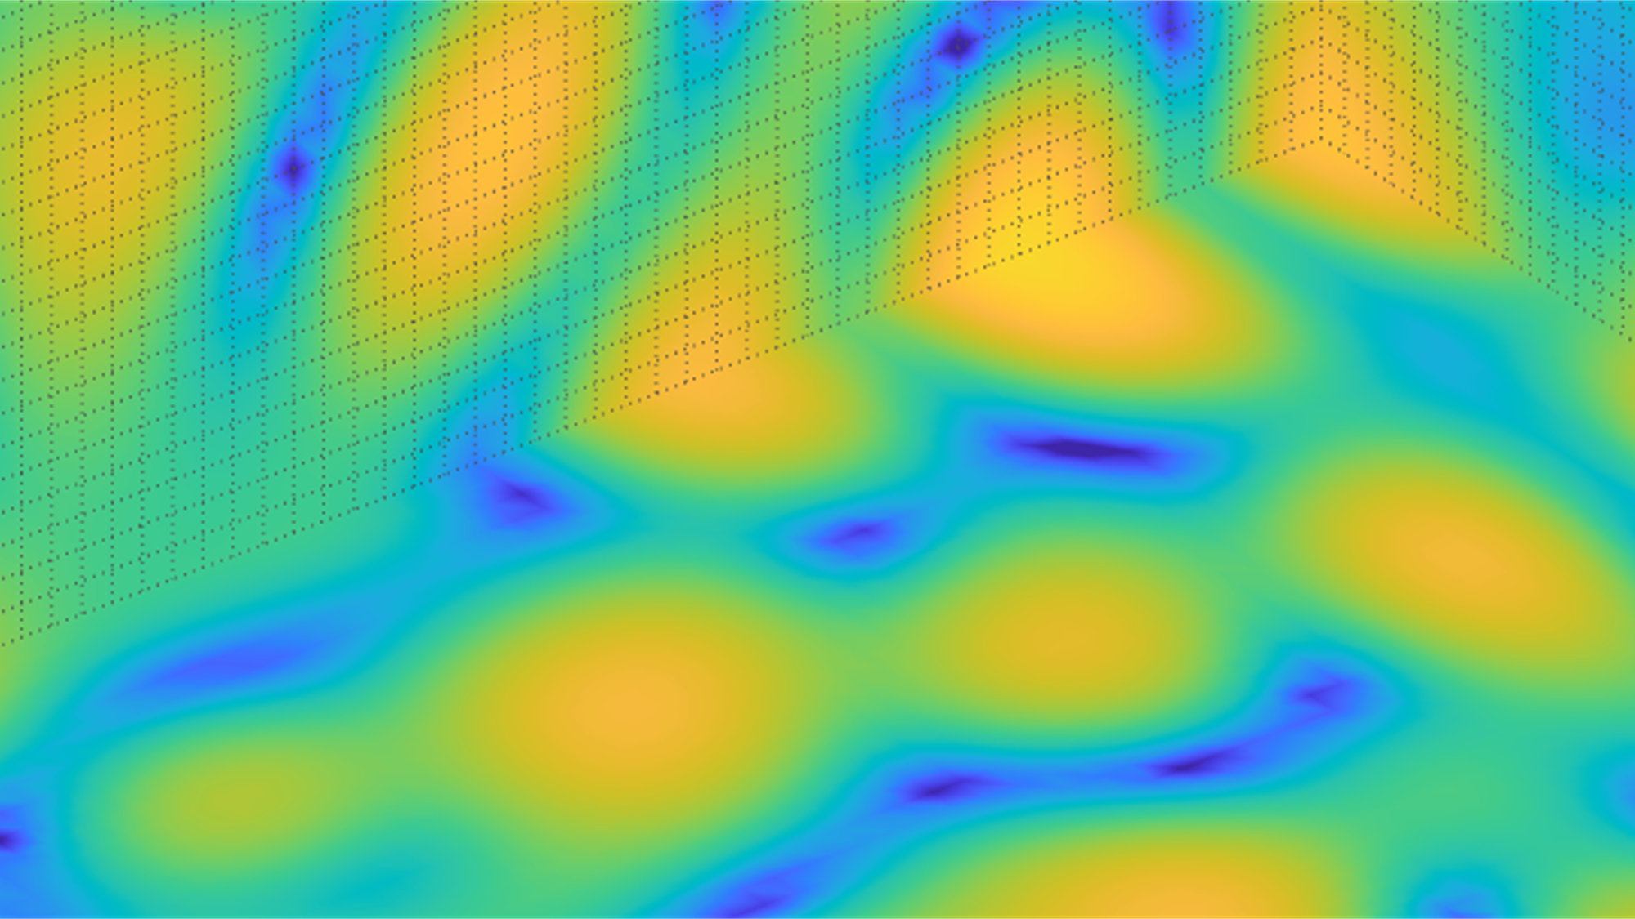
Basic Physics of Sound
Fundamentals of Acoustics and Sound
Dorte Hammershøi

Slide 2
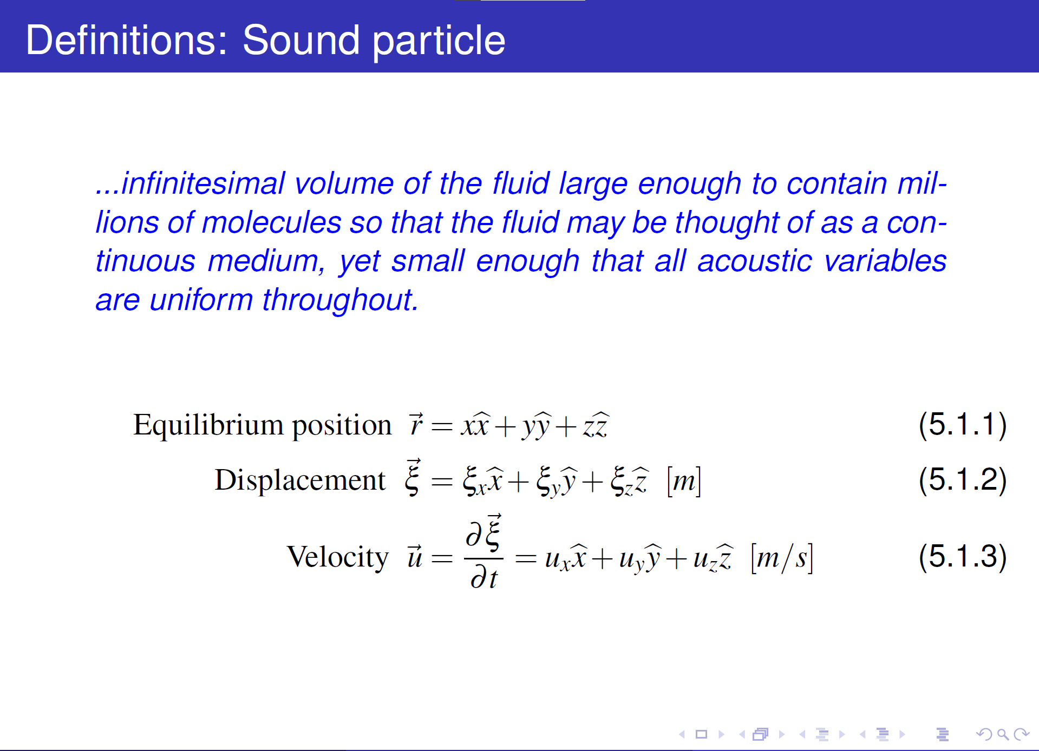
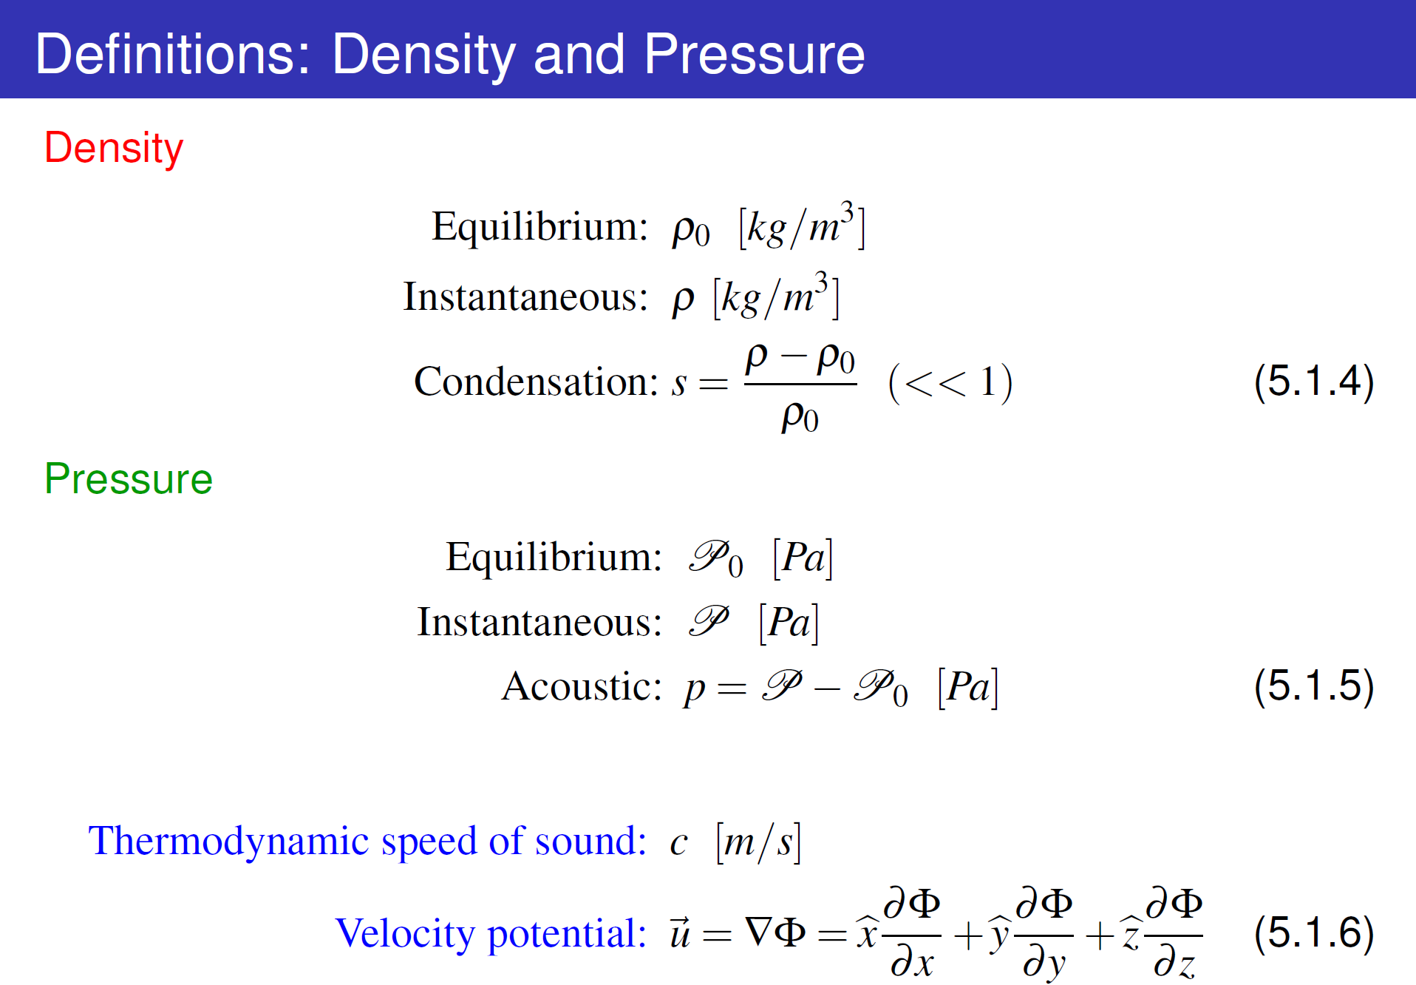
Relation of acoustic variables
All energy eventually dissipated into media, but slow process compared to the variations we are interested in
Pressure
Velocity
Condensation
Based on linearization of three physical laws:
Equation of State (1↔3)
Equation of Continuity (2↔3)
Force Equation (1↔2)
will constitute the wave equation
The following analyses are limited to waves of small amplitudes. Changes in density of the media due to the acoustic process are small compared to the equilibrium density, i.e., s << 1
Fluids!
Longitudinal motion only

Slide 3
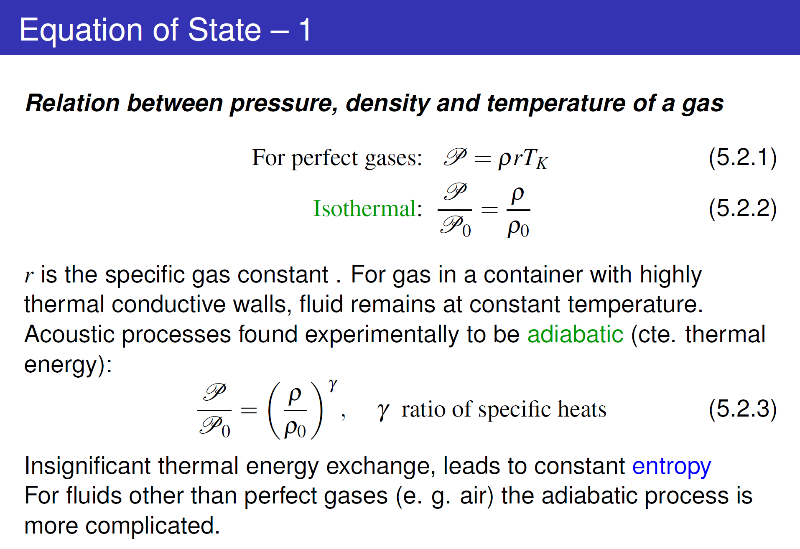
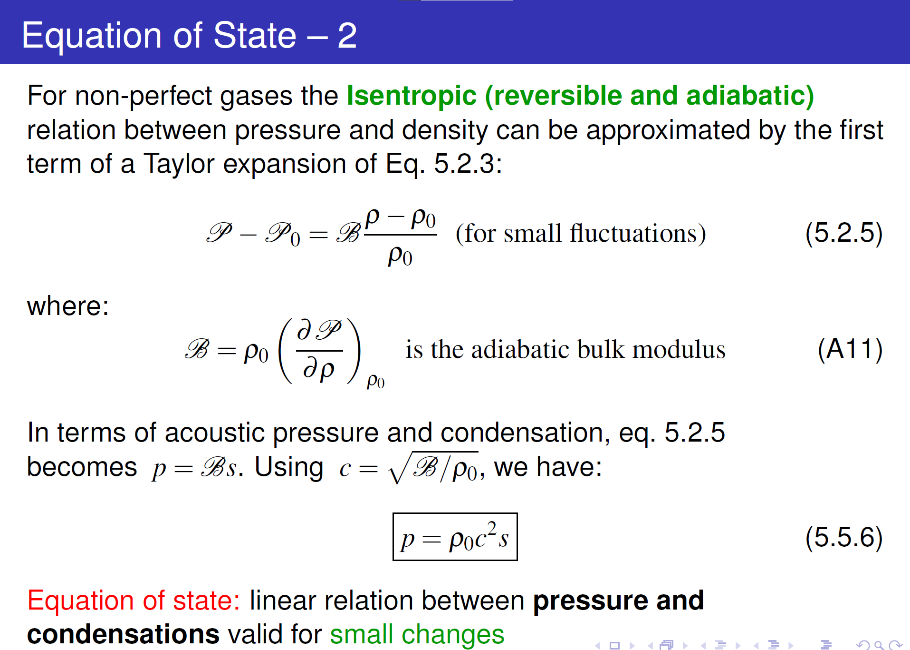
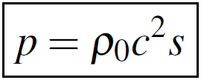
Relation of acoustic variables
All energy eventually dissipated into media, but slow process compared to the variations we are interested in
Pressure
Velocity
Condensation
Based on linearization of three physical laws:
Equation of State (1↔3)
Equation of Continuity (2↔3)
Force Equation (1↔2)
will constitute the wave equation
The following analyses are limited to waves of small amplitudes. Changes in density of the media due to the acoustic process are small compared to the equilibrium density, i.e., s << 1
Fluids!
Longitudinal motion only

Slide 4
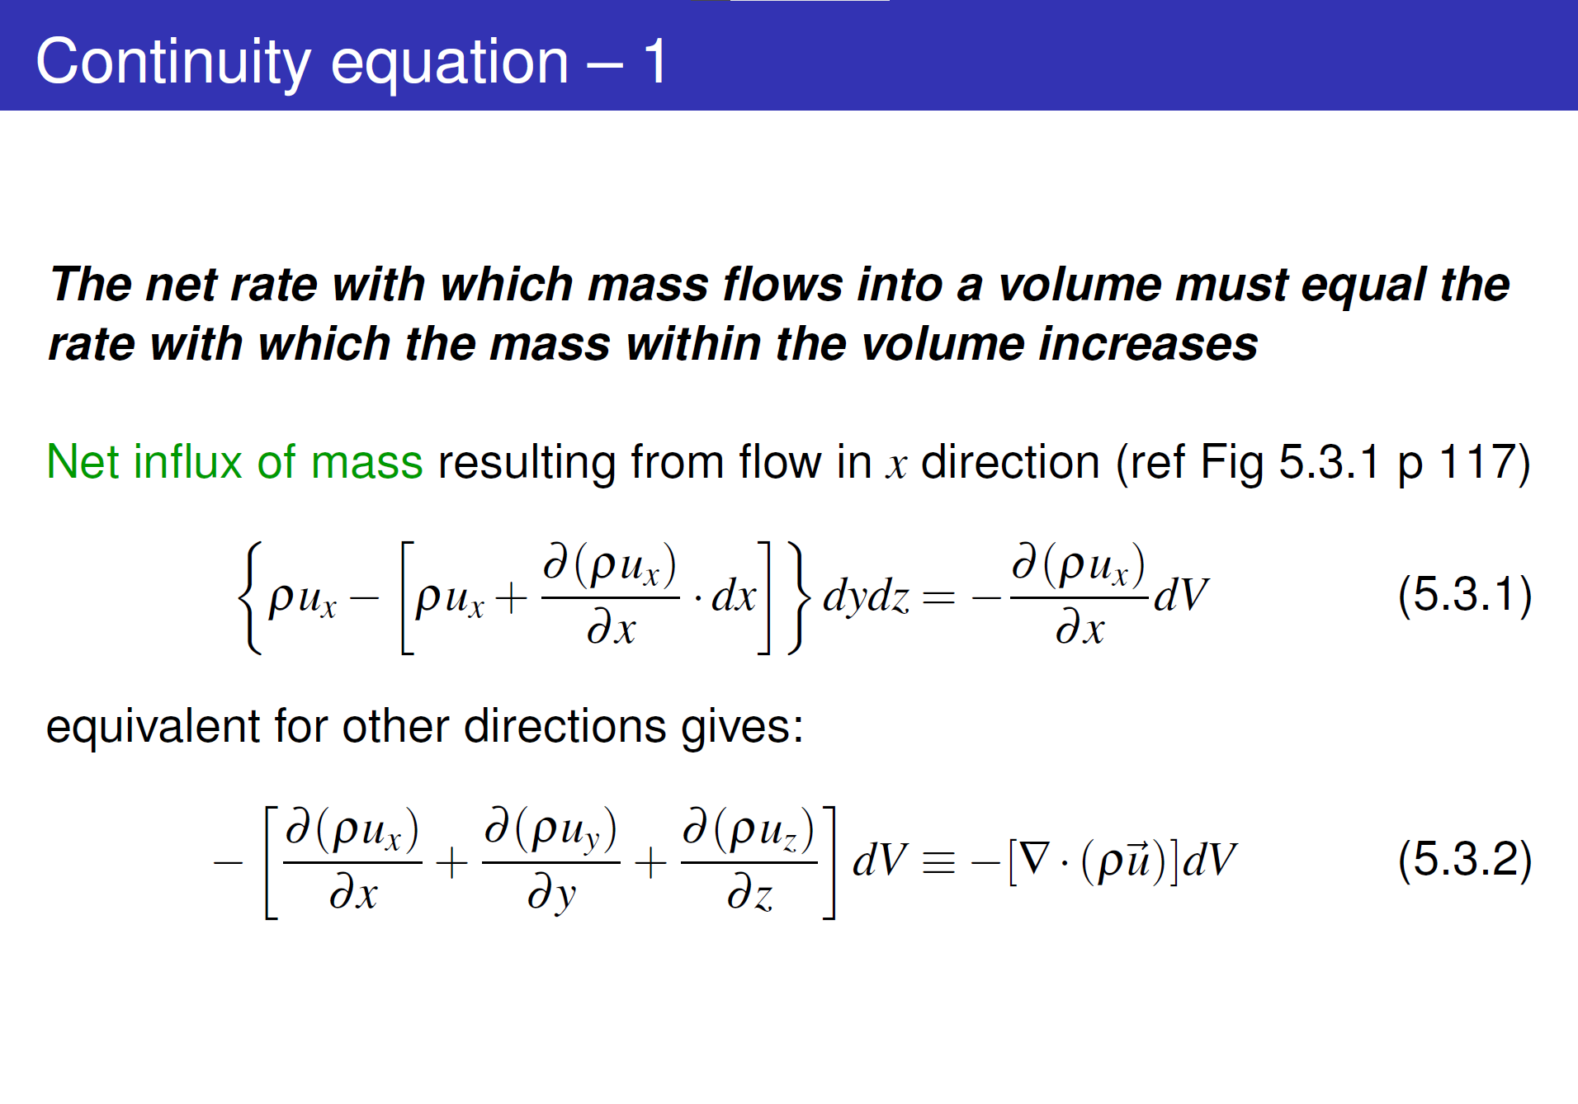
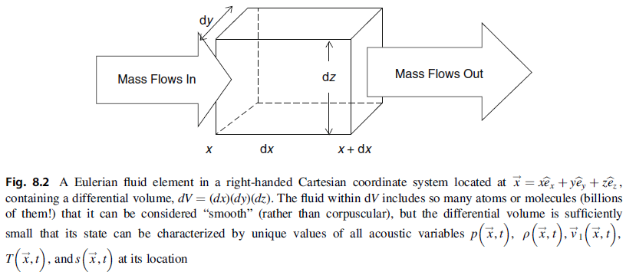
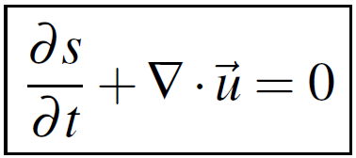
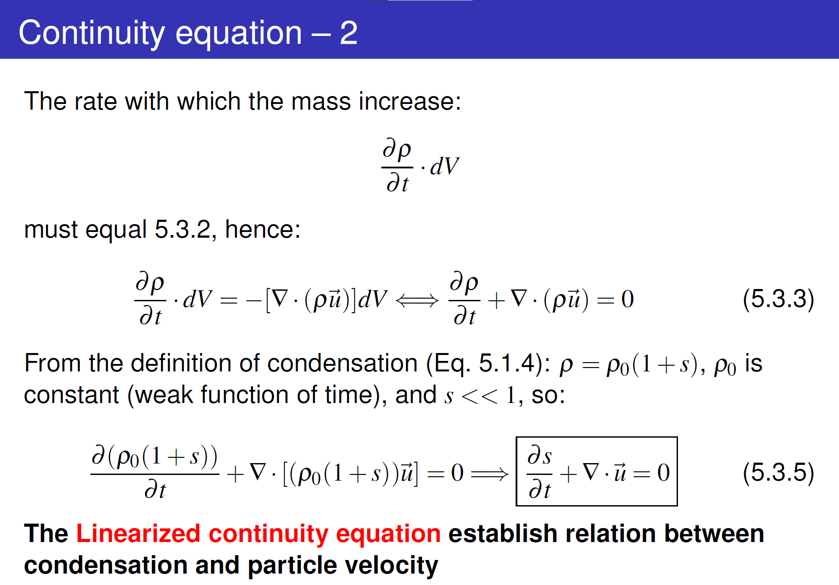
Relation of acoustic variables
All energy eventually dissipated into media, but slow process compared to the variations we are interested in
Pressure
Velocity
Condensation
Based on linearization of three physical laws:
Equation of State (1↔3)
Equation of Continuity (2↔3)
Force Equation (1↔2)
will constitute the wave equation
The following analyses are limited to waves of small amplitudes. Changes in density of the media due to the acoustic process are small compared to the equilibrium density, i.e., s << 1
Fluids!
Longitudinal motion only

Slide 5
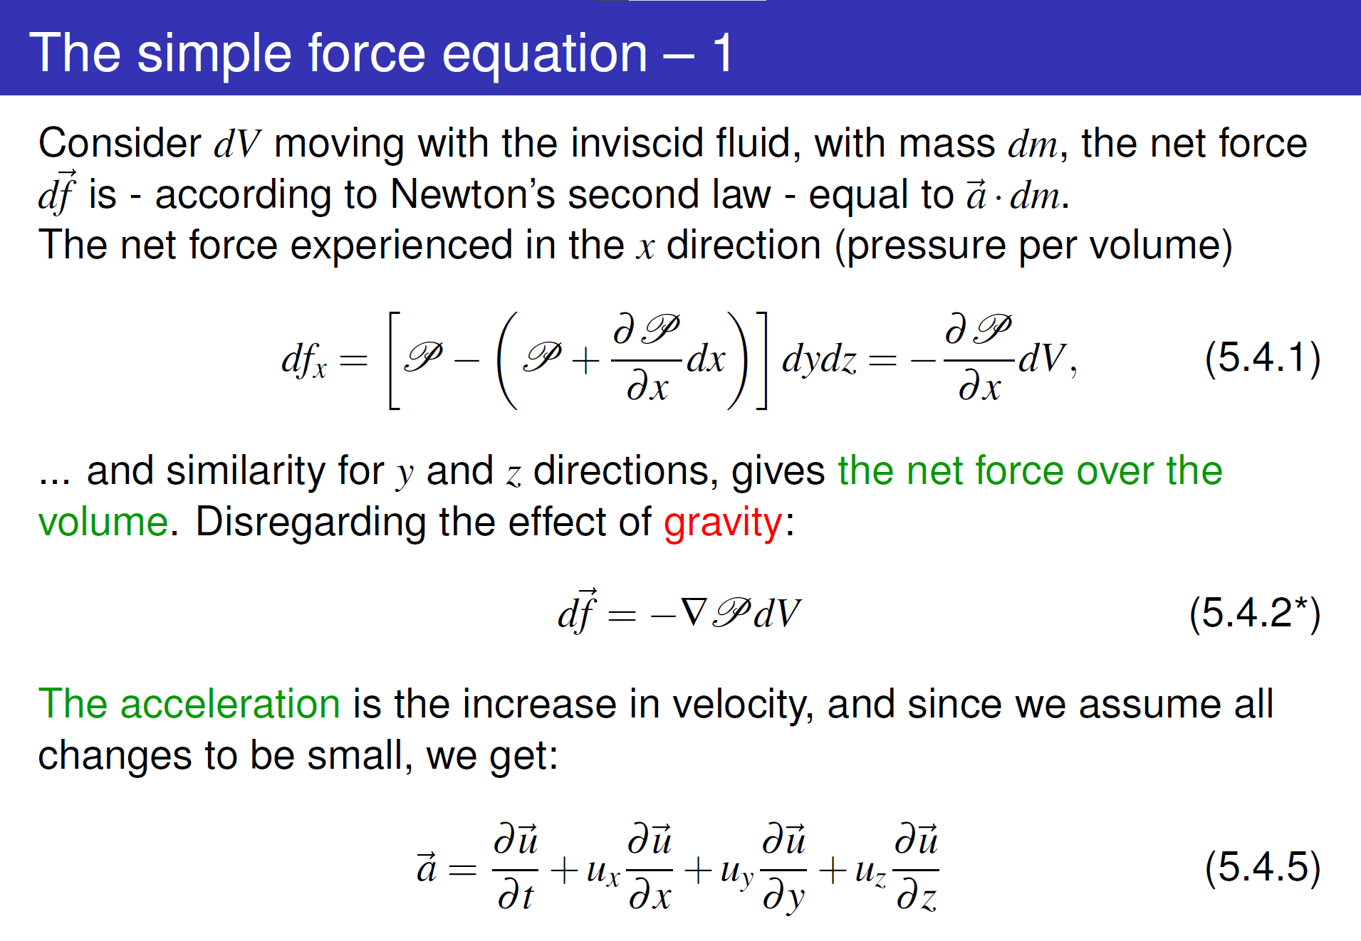
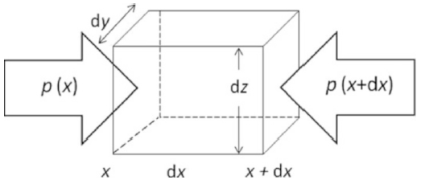
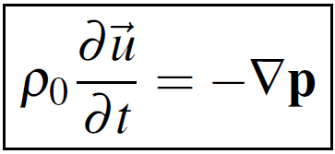
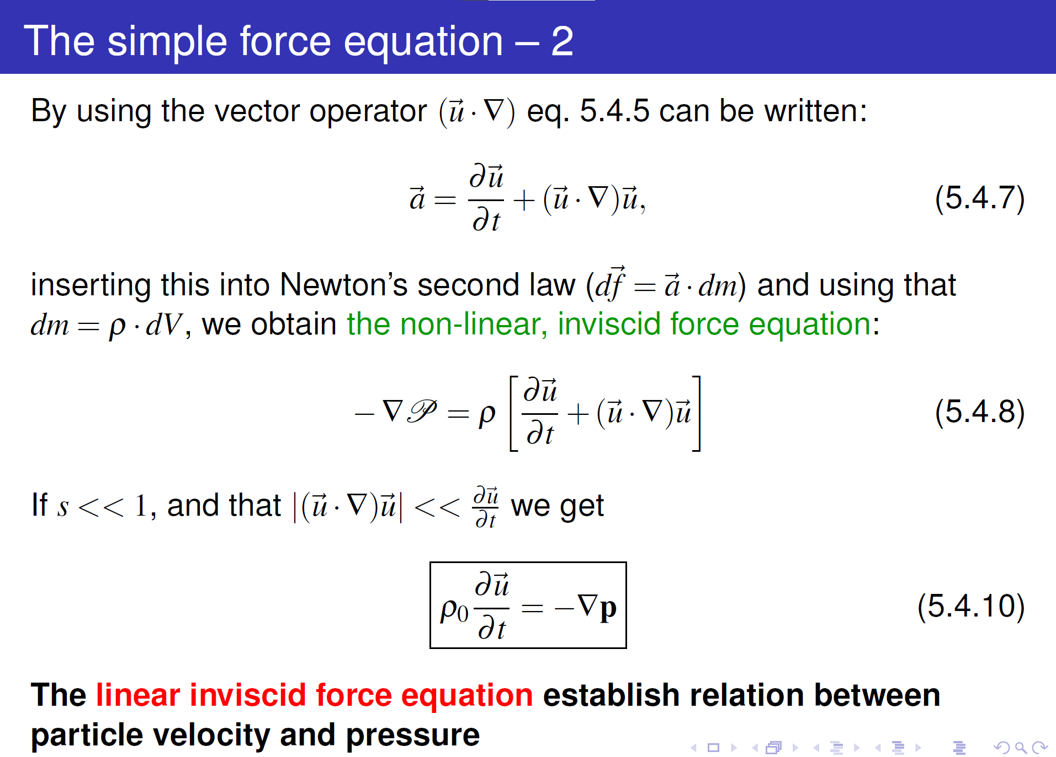
Relation of acoustic variables
All energy eventually dissipated into media, but slow process compared to the variations we are interested in
Pressure
Velocity
Condensation
Based on linearization of three physical laws:
Equation of State (1↔3)
Equation of Continuity (2↔3)
Force Equation (1↔2)
will constitute the wave equation
The following analyses are limited to waves of small amplitudes. Changes in density of the media due to the acoustic process are small compared to the equilibrium density, i.e., s << 1
Fluids!
Longitudinal motion only

Slide 6
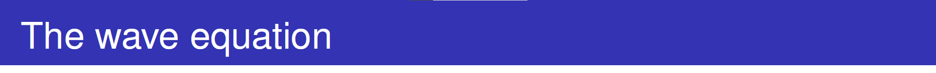
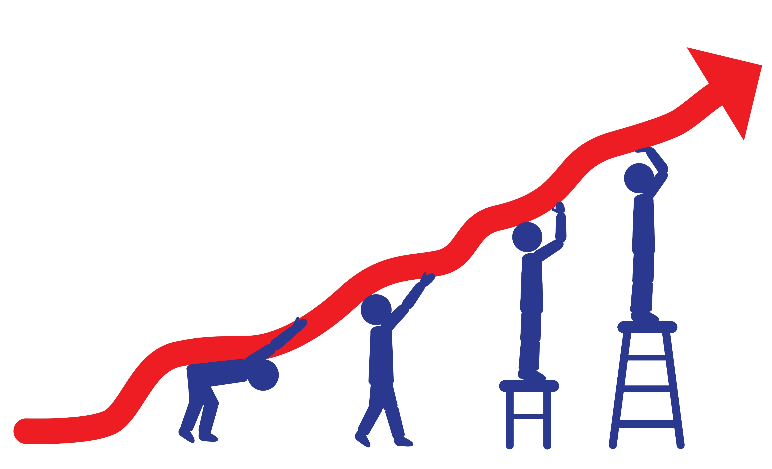
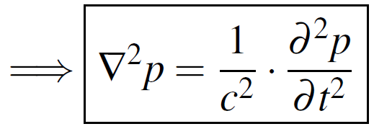
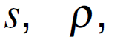
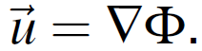
Relation of acoustic variables
All energy eventually dissipated into media, but slow process compared to the variations we are interested in
Pressure
Velocity
Condensation
Based on linearization of three physical laws:
Equation of State (1↔3) c. Eliminate condensation
Equation of Continuity (2↔3) b. Take time derivative, eliminate divergence
Force Equation (1↔2) a. Take divergence
will constitute the wave equation
The following analyses are limited to waves of small amplitudes. Changes in density of the media due to the acoustic process are small compared to the equilibrium density, i.e., s << 1
Fluids!
Longitudinal motion only
All other acoustic variables also satisfy the wave equation:
and

Slide 7
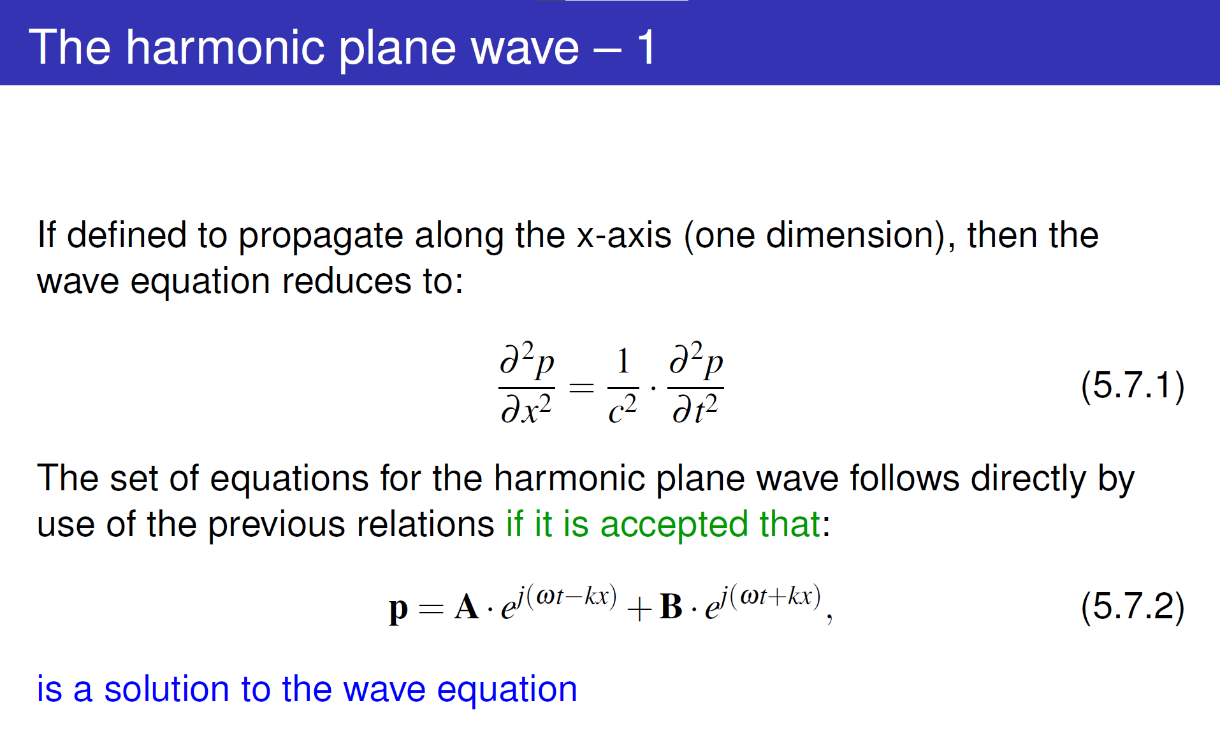
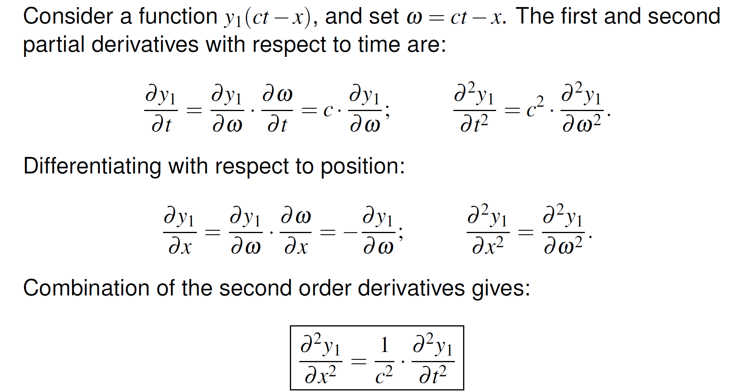
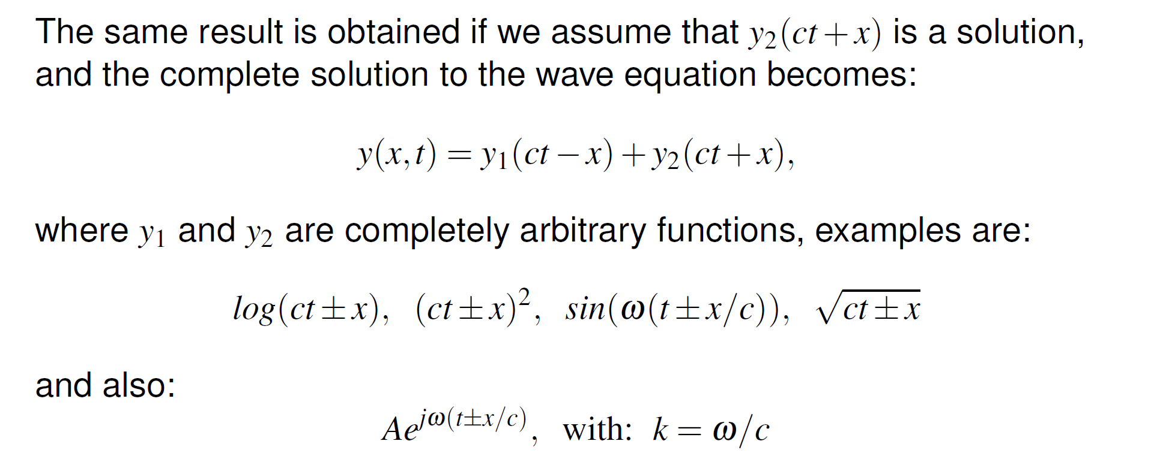
Harmonic plane wave
All energy eventually dissipated into media, but slow process compared to the variations we are interested in
Universal solution:
Can represent all complex signals (using Fourier analysis)
Resulting particle placement obtained by simple superposition of independent excitations
Fluids!
Longitudinal motion only

Slide 8

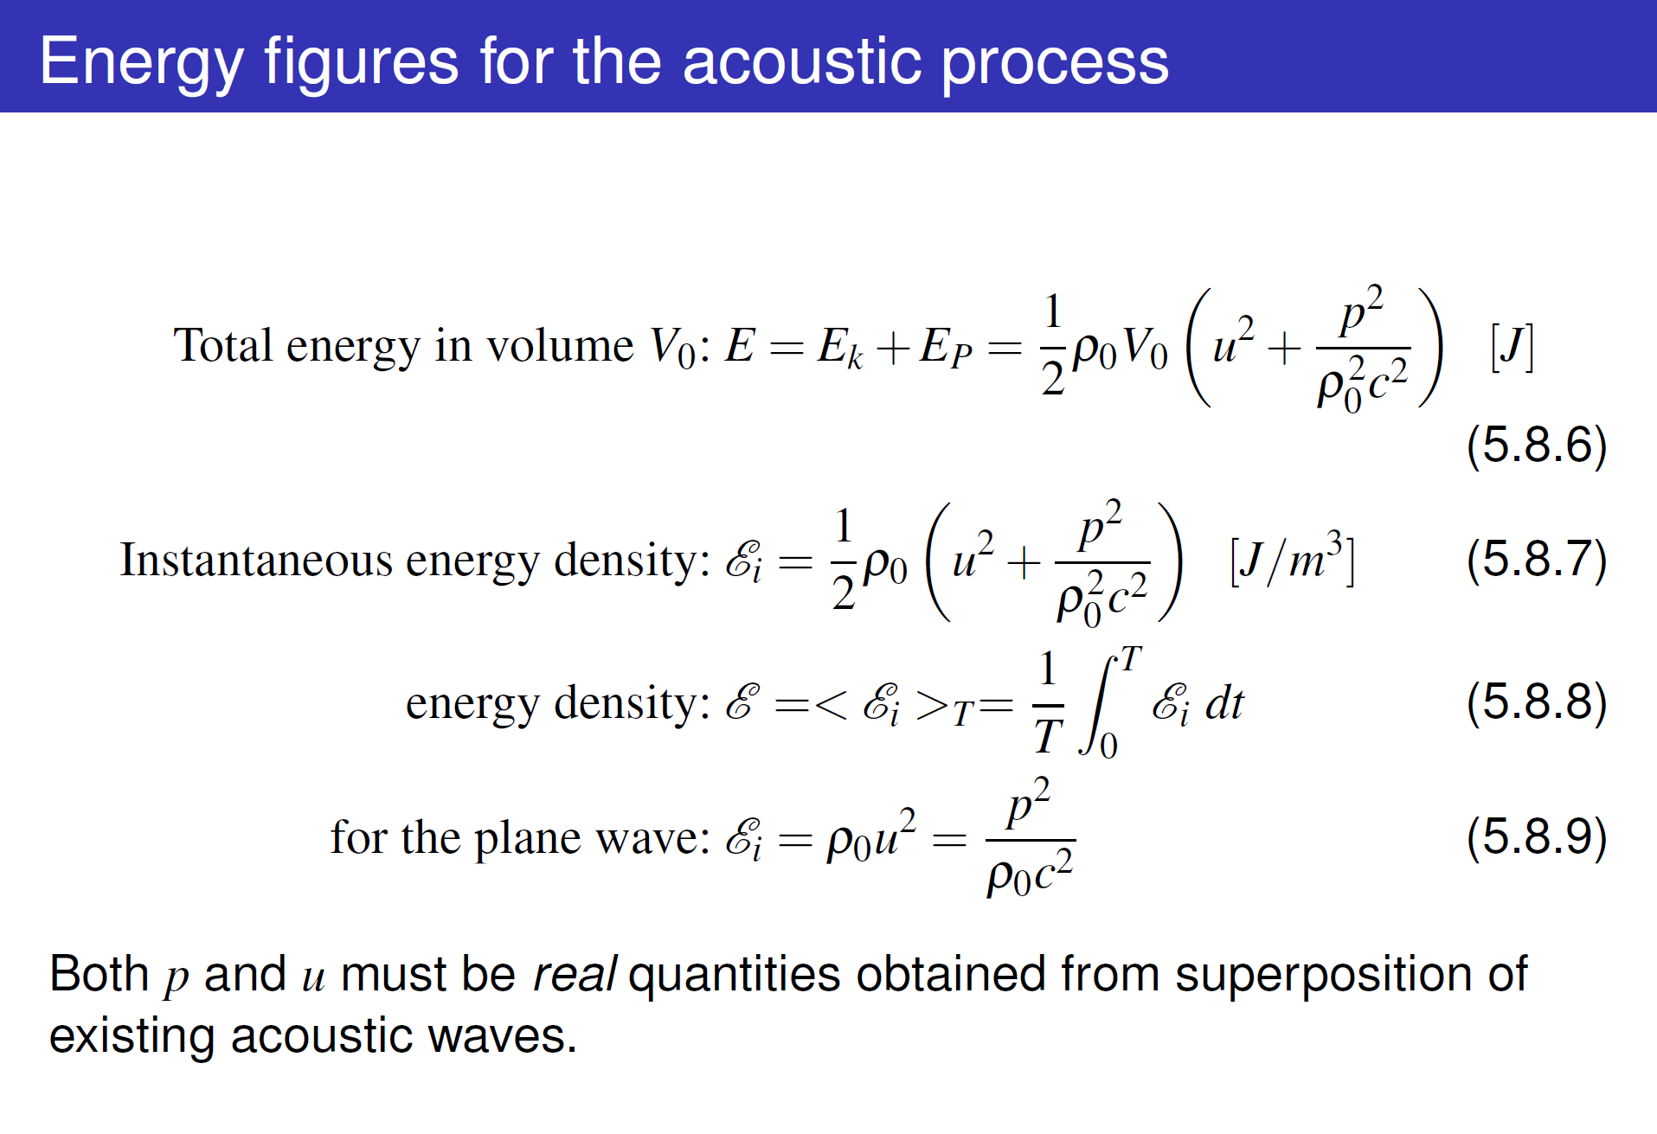
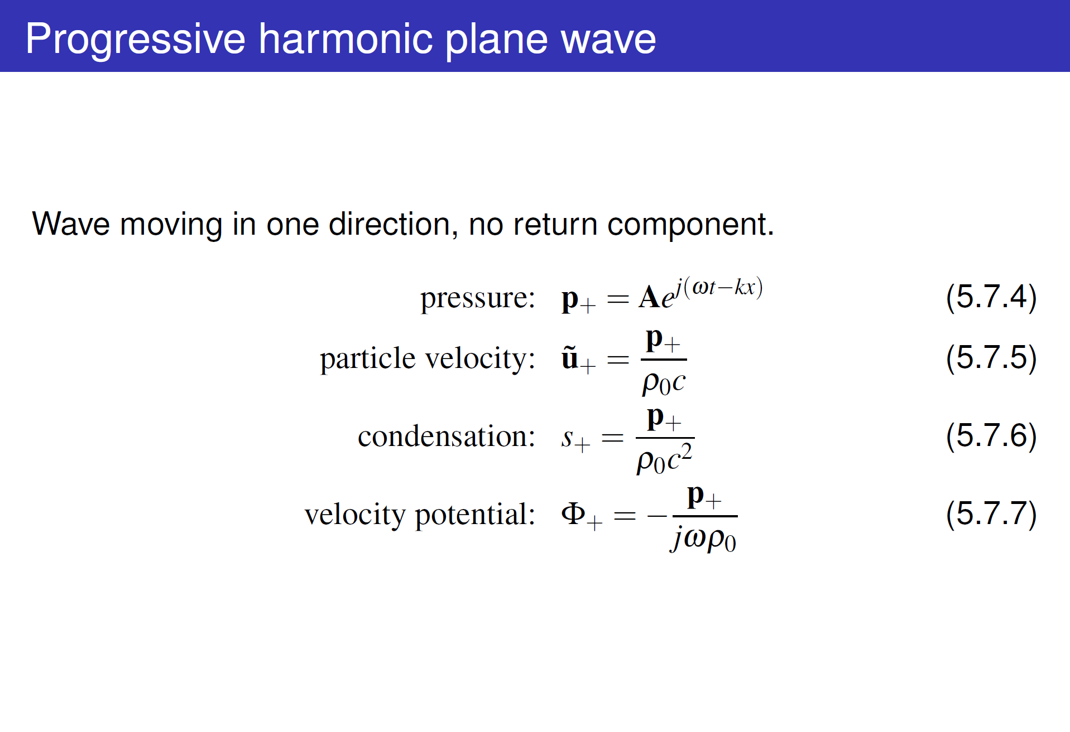
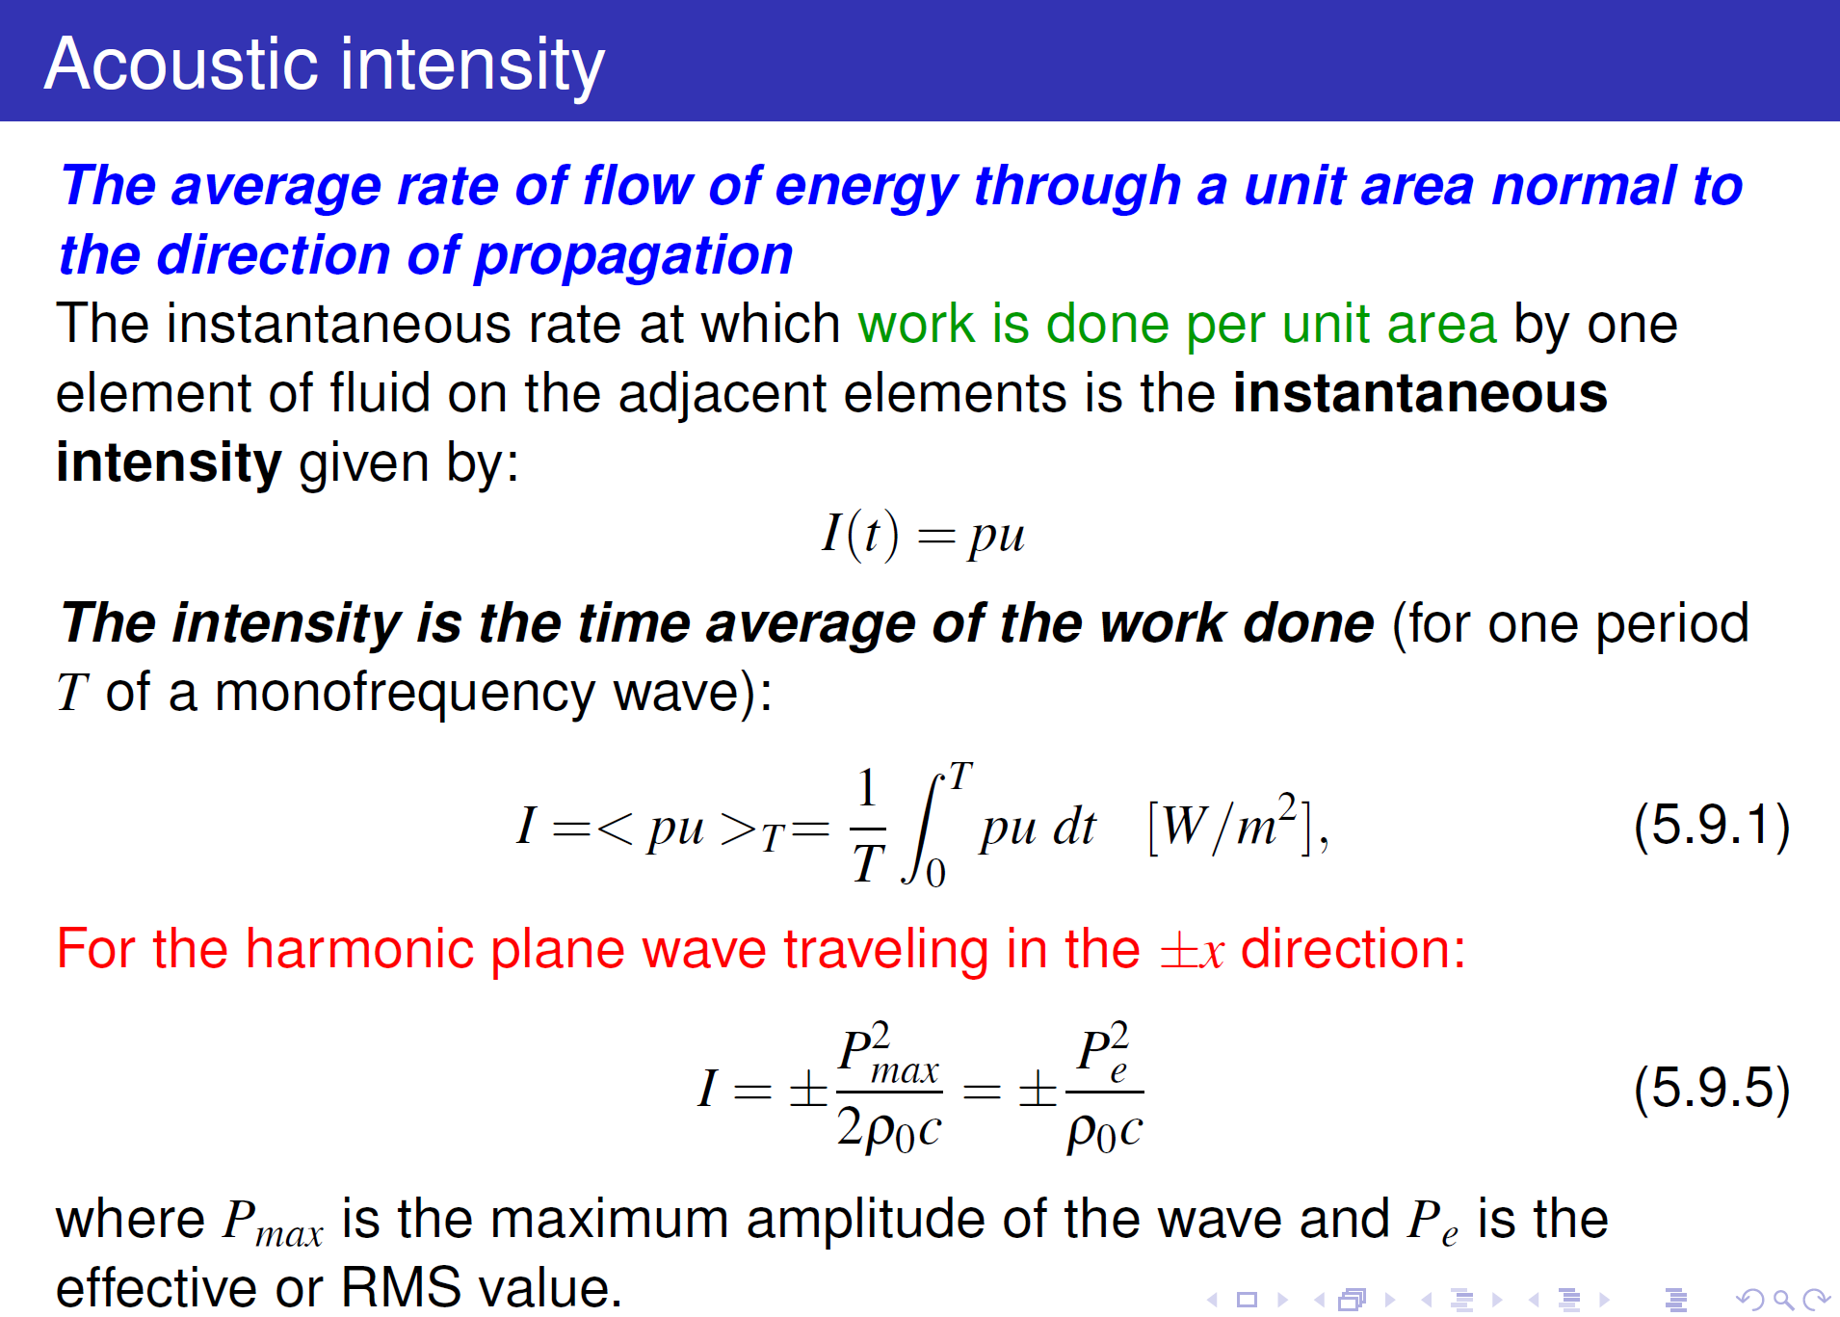
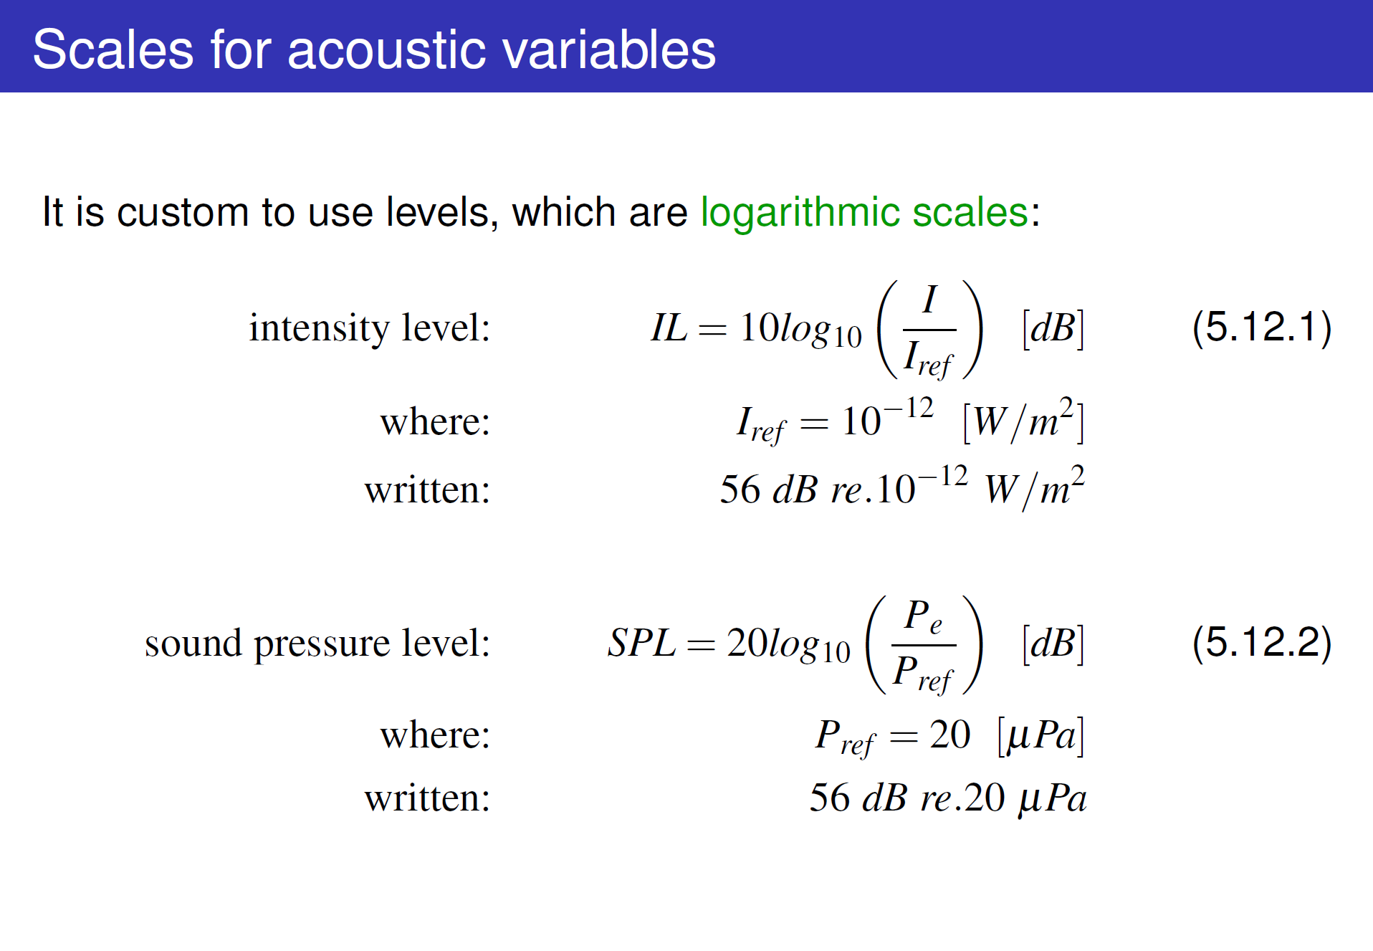
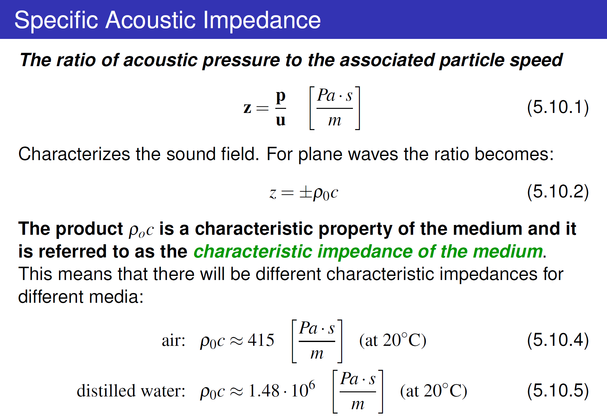
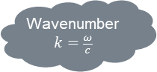
Wavenumber
$$k=\frac{ω}{c}$$

Slide 9
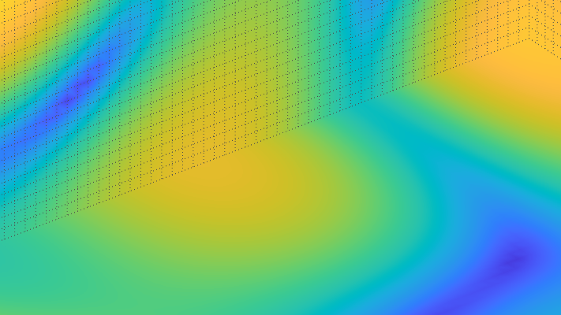
BREAK

Slide 10
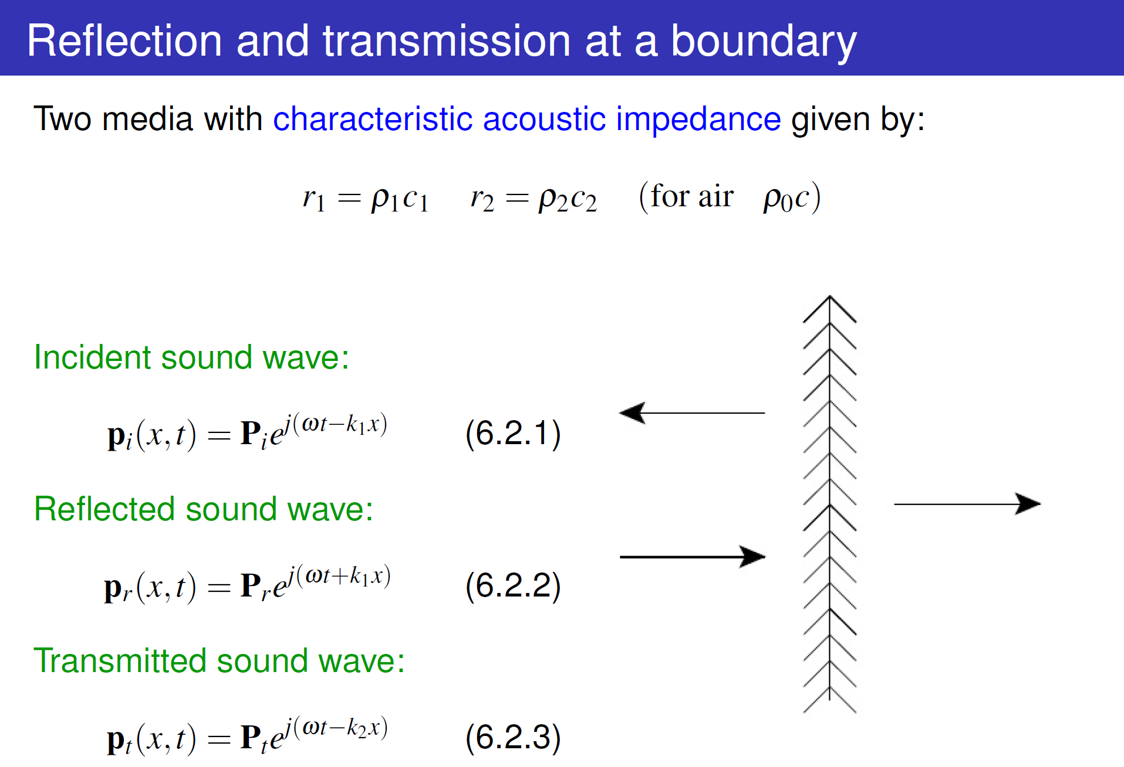
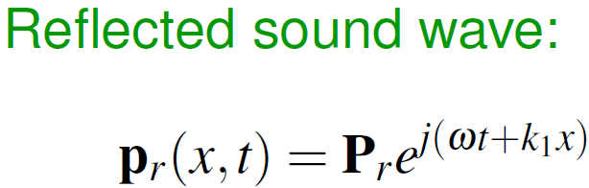
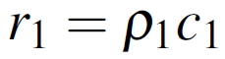
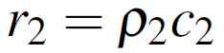
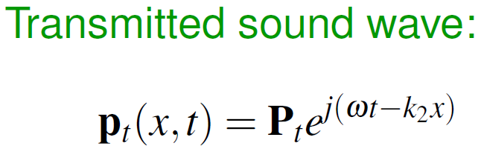
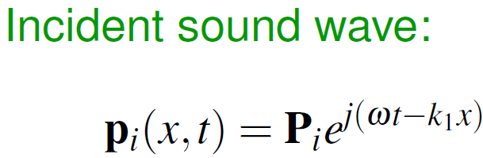
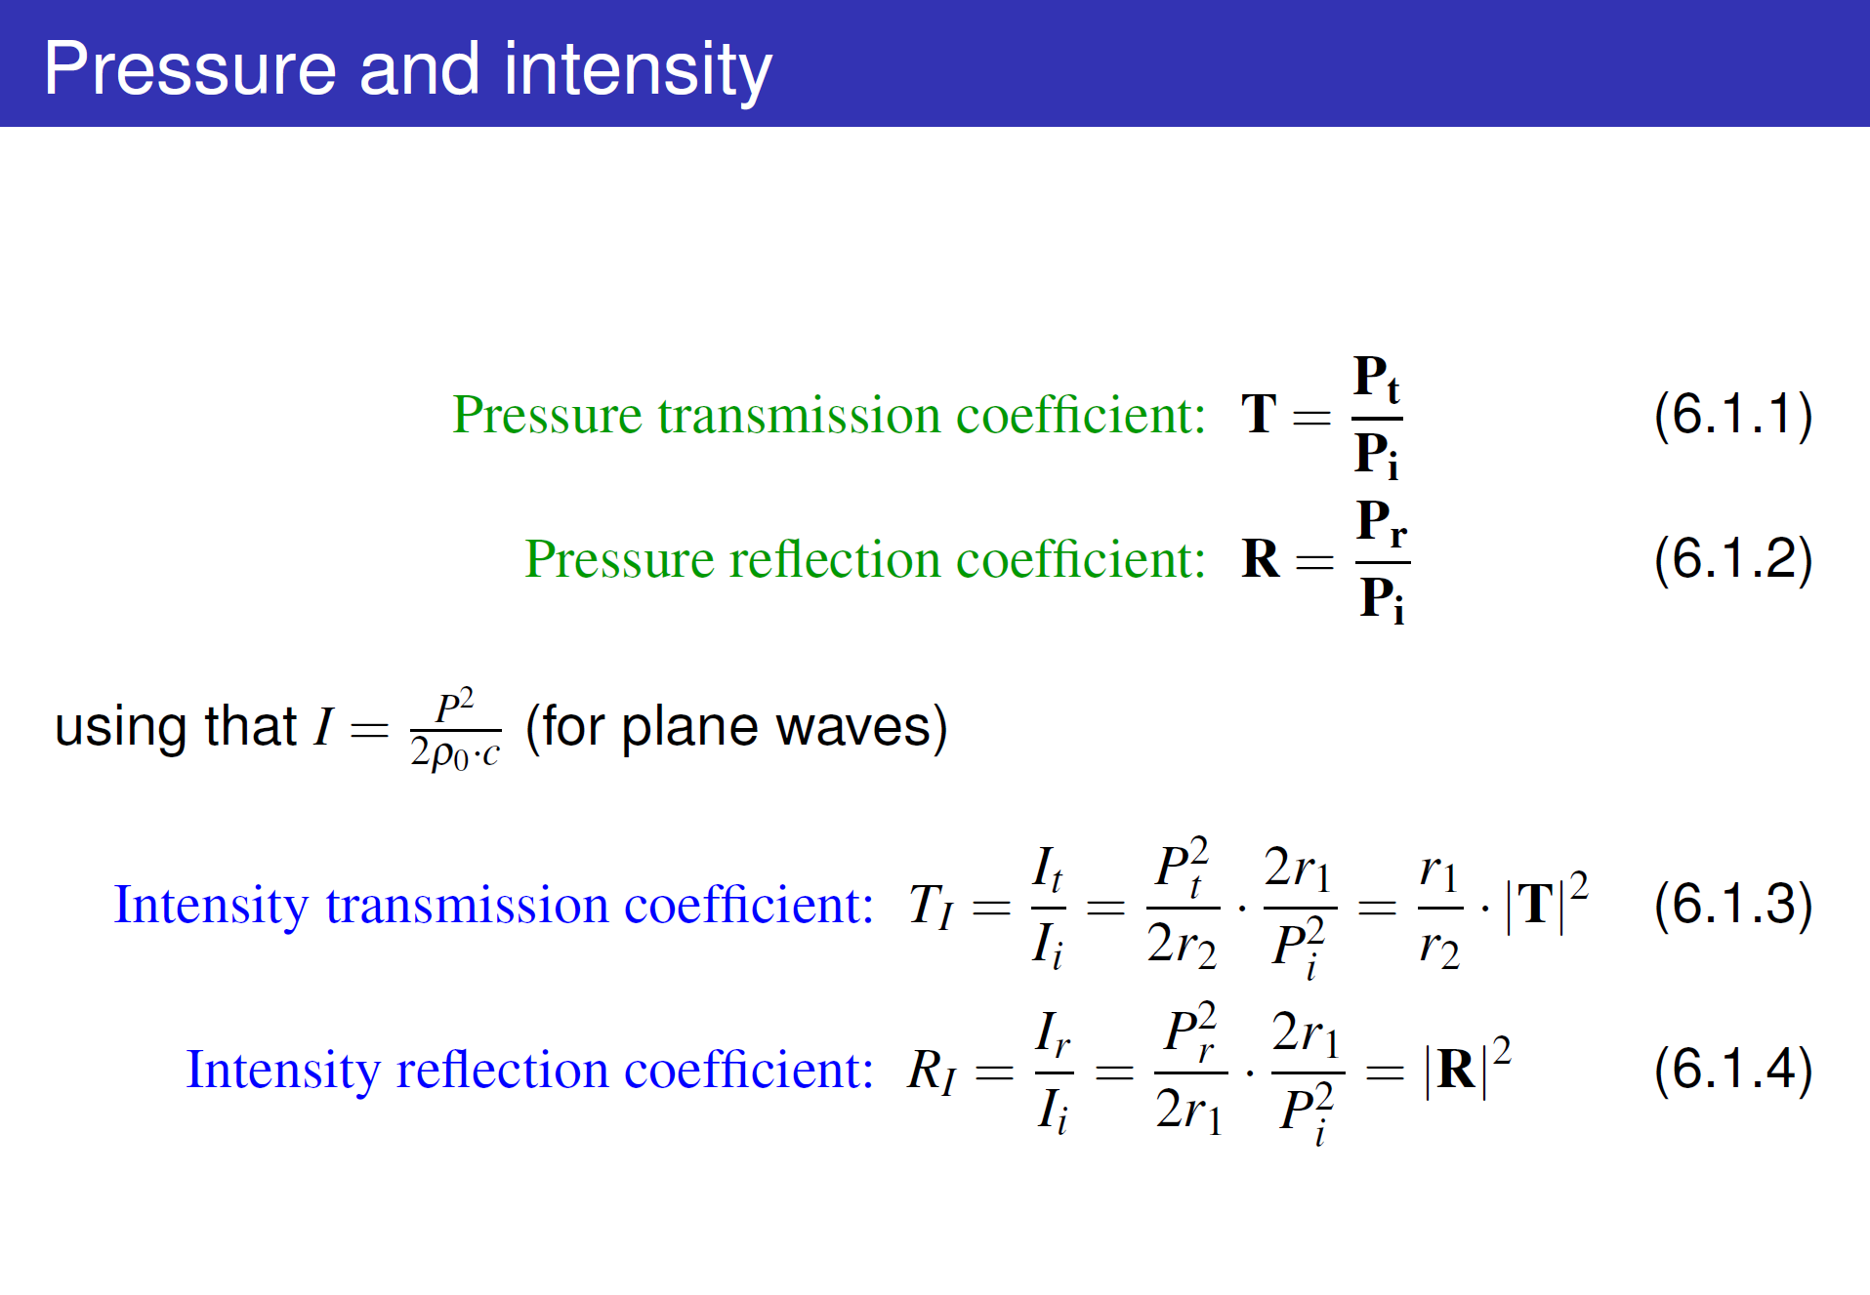
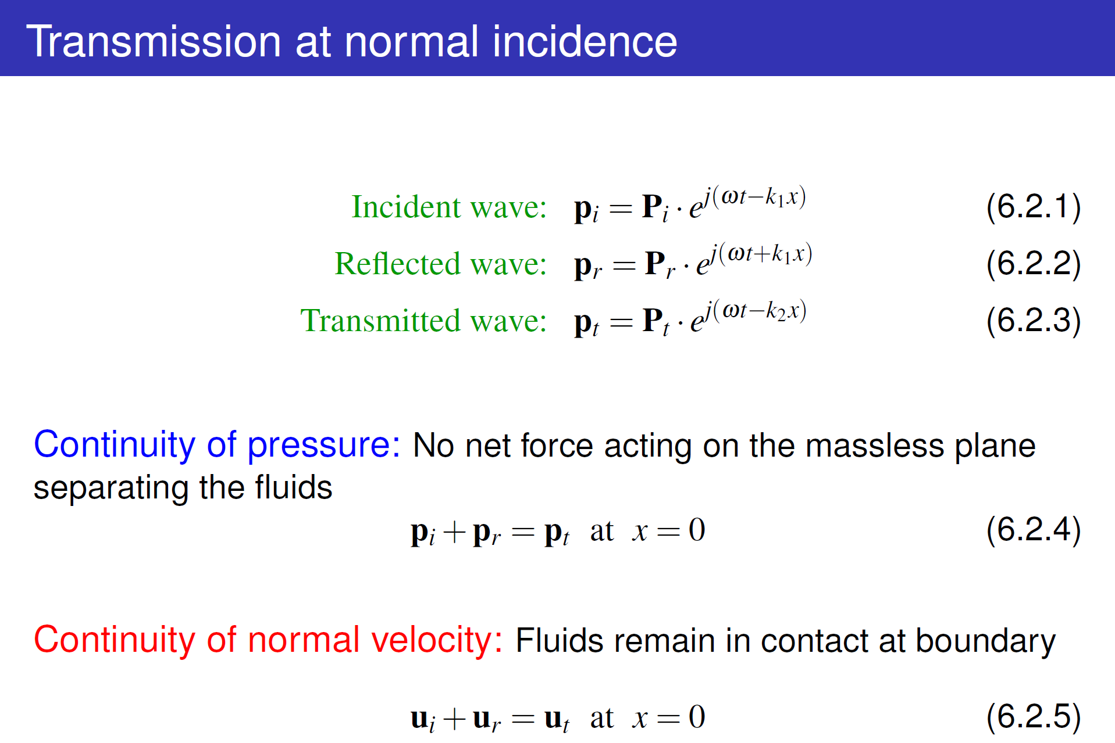
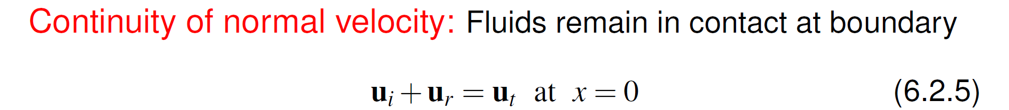
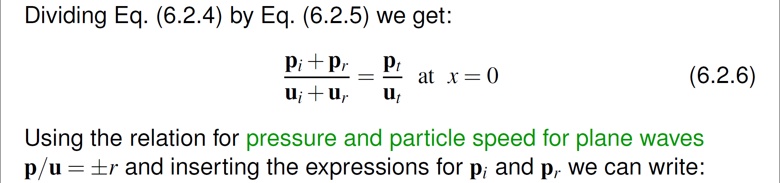
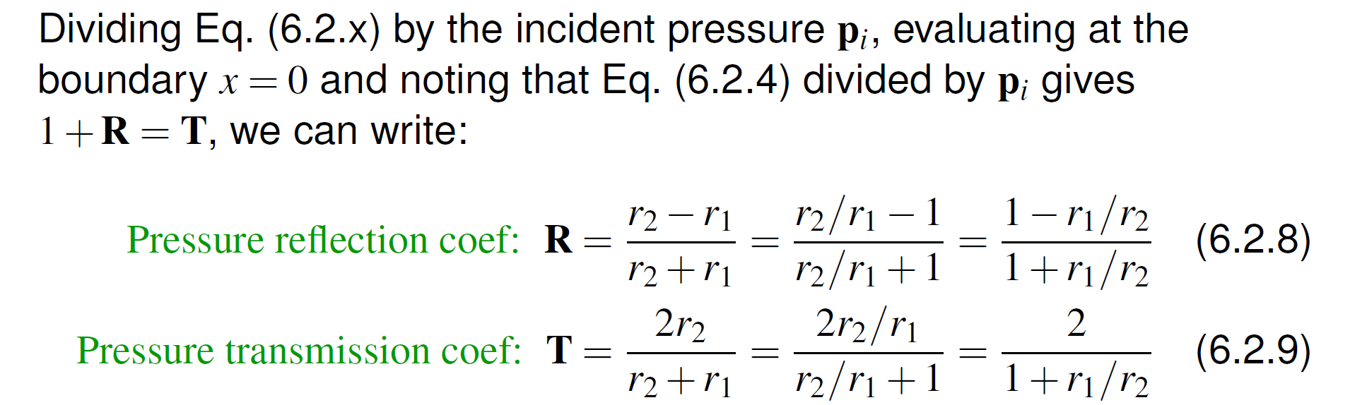
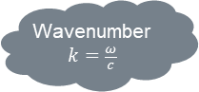
Plane wave at media boundary
Wavenumber
$$k=\frac{ω}{c}$$
Boundary between two fluids (longitudinal motion only)

Slide 11
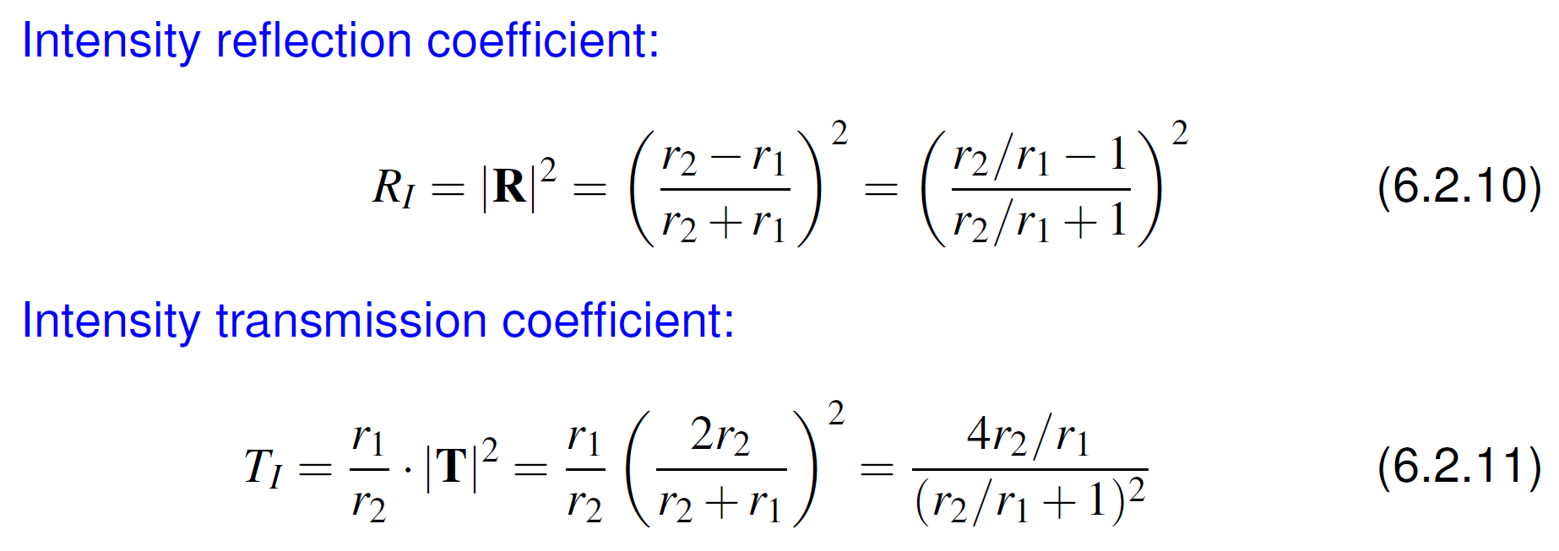
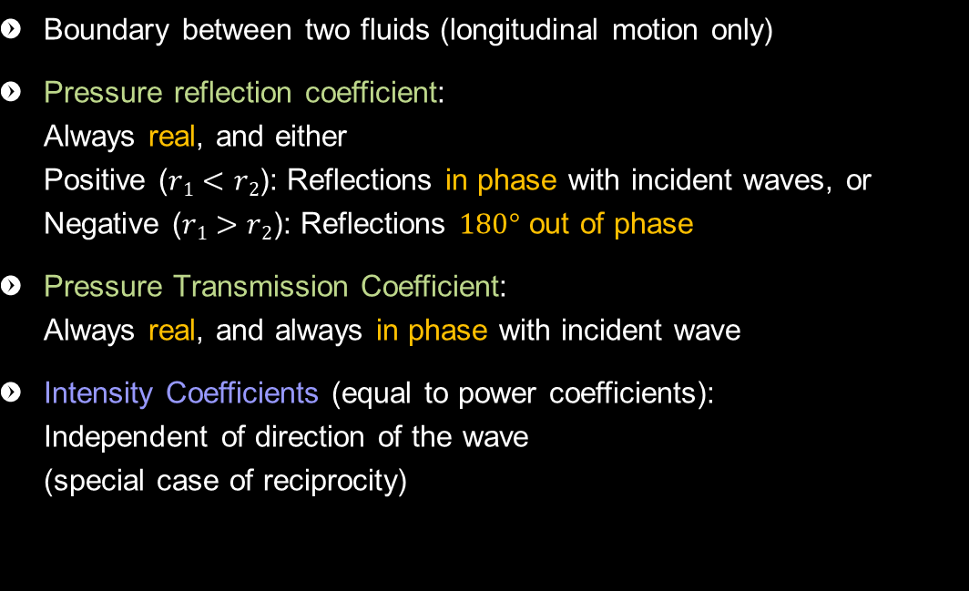
Plane wave at media boundary
Wavenumber
$$k=\frac{ω}{c}$$
Boundary between two fluids (longitudinal motion only)
Pressure reflection coefficient: Always real, and either Positive ($r1<r2$): Reflections in phase with incident waves, or Negative ($r1>r2$): Reflections $180°$ out of phase
Pressure Transmission Coefficient: Always real, and always in phase with incident wave
Intensity Coefficients (equal to power coefficients): Independent of direction of the wave (special case of reciprocity)

Slide 12
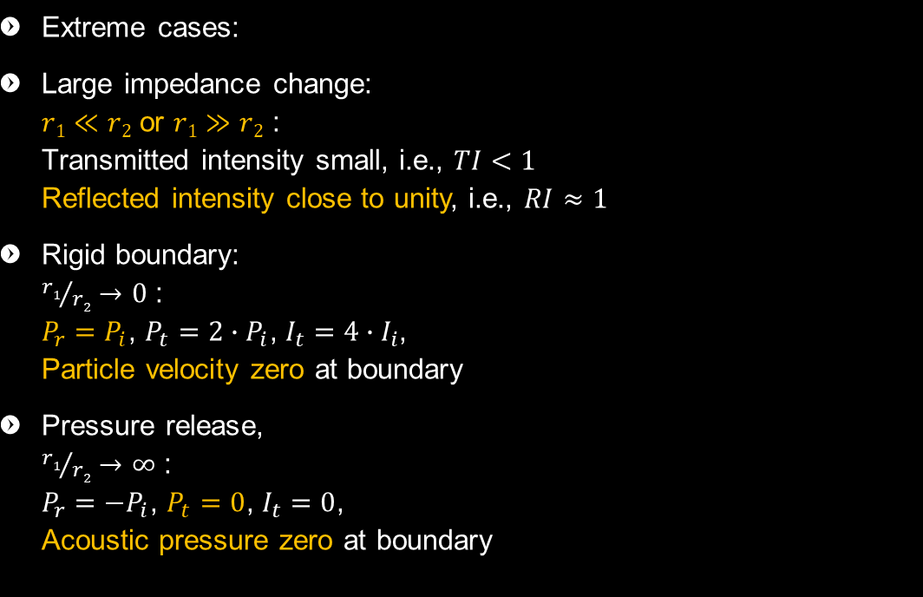
Plane wave at media boundary
Wavenumber
$$k=\frac{ω}{c}$$
Extreme cases:
Large impedance change: $r1≪r2$ or $r1≫r2$ : Transmitted intensity small, i.e., $TI<1$ Reflected intensity close to unity, i.e., $RI≈1$
Rigid boundary: ${r1}/{r2}→0$ : $P_{r}=P_{i}$, $P_{t}=2∙P_{i}$, $I_{t}=4∙I_{i}$, Particle velocity zero at boundary
Pressure release, ${r1}/{r2}→∞$ : $P_{r}={−P}_{i}$, $P_{t}=0$, $I_{t}=0$, Acoustic pressure zero at boundary

Slide 13
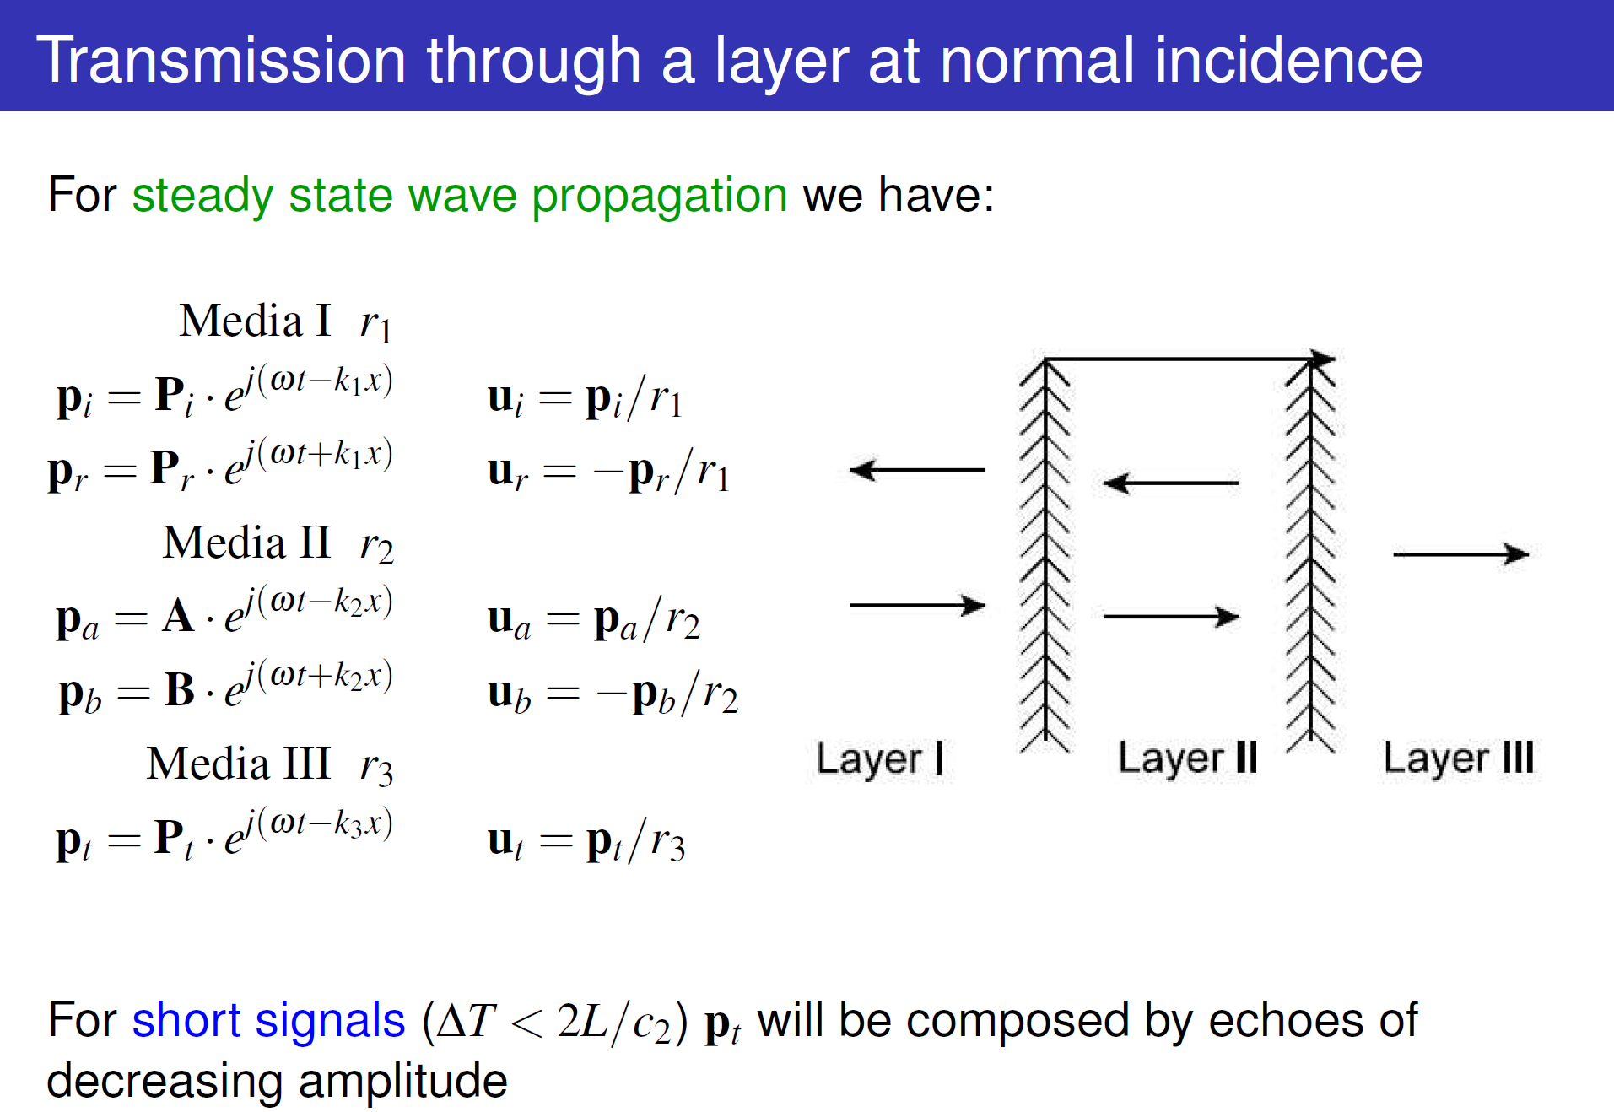
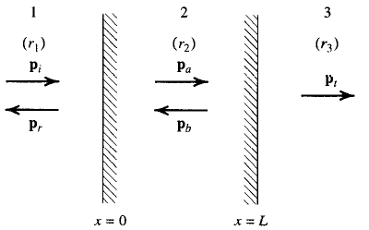
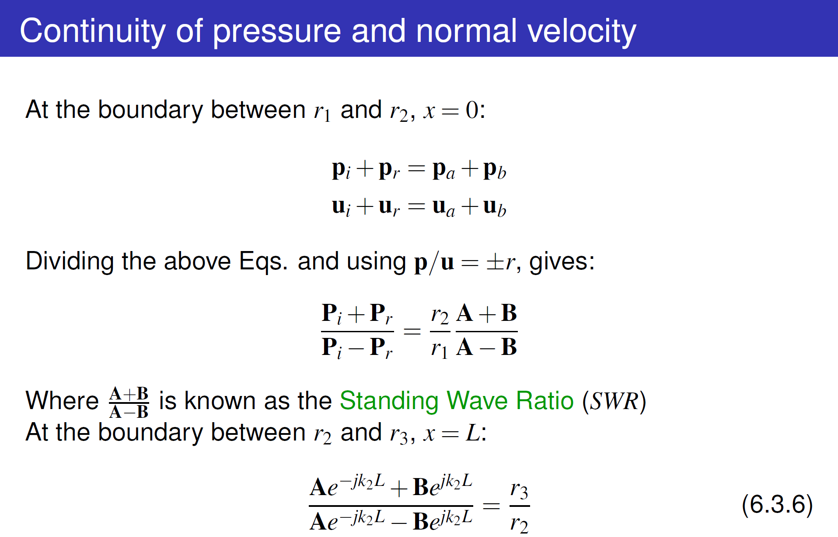
Plane waves through layers
Wavenumber
$$k=\frac{ω}{c}$$
Fluids, i.e., longitudinal motion only

Slide 14
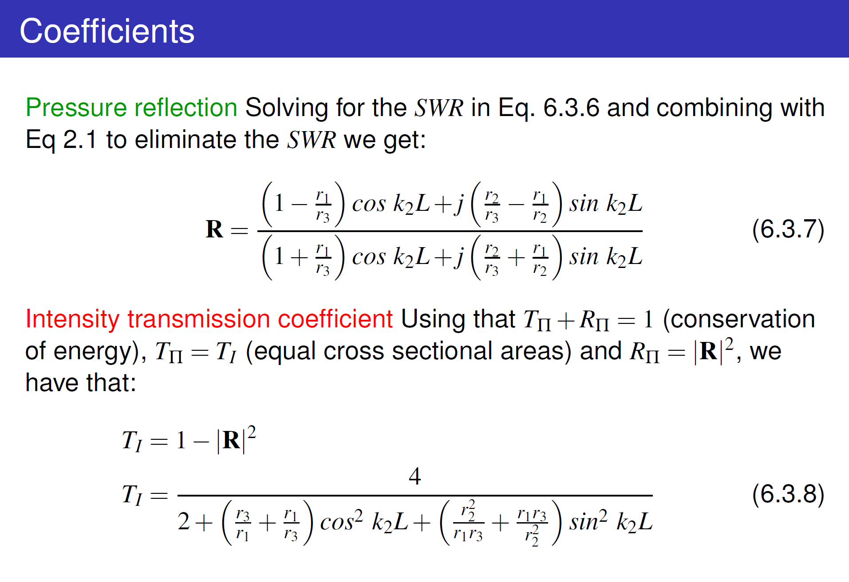
Plane waves through layers
Wavenumber
$$k=\frac{ω}{c}$$
Fluids, i.e., longitudinal motion only

Slide 15
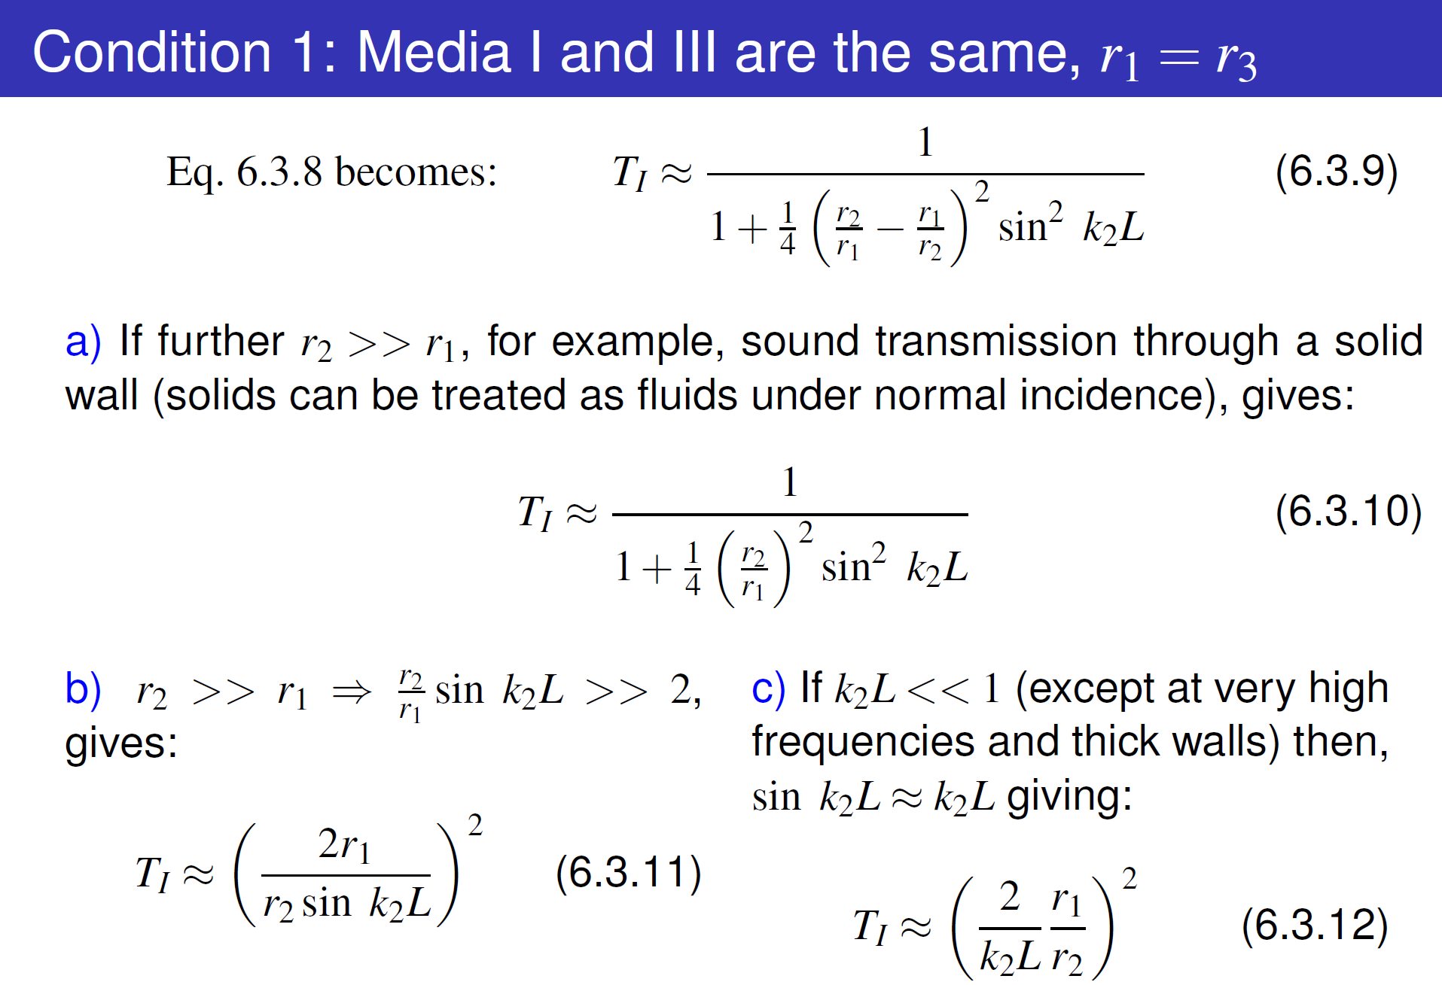
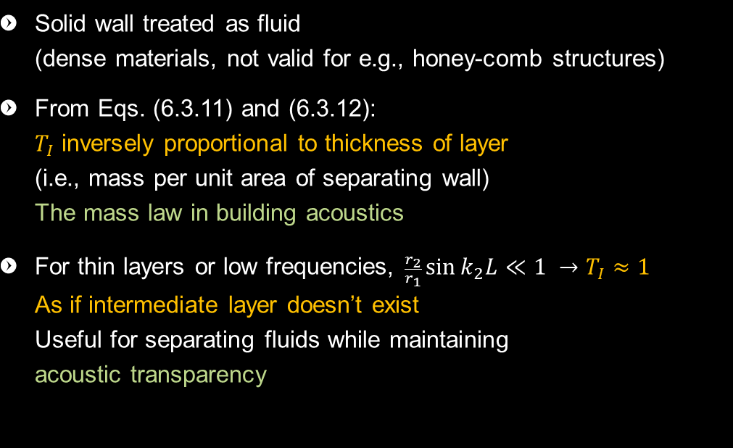
Special case “wall”
Wavenumber
$$k=\frac{ω}{c}$$
Solid wall treated as fluid (dense materials, not valid for e.g., honey-comb structures)
From Eqs. (6.3.11) and (6.3.12): $T_{I}$ inversely proportional to thickness of layer (i.e., mass per unit area of separating wall) The mass law in building acoustics
For thin layers or low frequencies, $\frac{r_{2}}{r_{1}}\sin{k_{2}L}≪1 →T_{I}≈1$ As if intermediate layer doesn’t exist Useful for separating fluids while maintaining acoustic transparency

Slide 16




Special cases
Wavenumber
$$k=\frac{ω}{c}$$
Condition 2: a) $T_{I}$ is independent of $r_{2}$! (for a wide frequency range) b) $T_{I}$ is equivalent to $T_{I}$ for the two media situation, i.e., (Eq. (6.2.11) with $r_{1}$ and $r_{3}$ instead of $r_{1}$ and $r_{2}$ c) If $r_{1}=r_{3}$, media II is completely transparent (as if $r_{2}$ doesn’t exist) Acoustic transparency by design (${r_{1}, r_{2}, r}_{3}$, and small $L$)
Condition 3: For given frequencies, i.e., $k_{2}L=nπ$ ($n$ an integer), same applies Acoustic transparency by design ($L≈n\frac{λ_{2}}{2}$)
Condition 4: For given frequencies, complete transmission for $r_{2}=\sqrt{r_{1}⋅r_{3}}$ Acoustic transparency by design (selective)

Slide 17




Oblique incidence Rayleigh coefficient
Wavenumber
$$k=\frac{ω}{c}$$

Slide 18


Oblique incidence Rayleigh coefficient
Wavenumber
$$k=\frac{ω}{c}$$
$c_{1}>c_{2}; θ_{t}$ is real and less than $θ_{i}$ Transmitted wave exists and bends towards the normal
$c_{1}<c_{2}$ and $θ_{i}<θ_{c}$; $θ_{t}$ is real and greater than $θ_{i}$ Transmitted wave exists and bends away from the normal
$c_{1}<c_{2}$ and $θ_{i}>θ_{c}$; $1<\sin{θ_{i}} ∈ℝ→\cos{θ_{t}}∈𝕀$! Transmitted pressure: $p_{t}=P_{t}e^{−λx}e^{−j(ωt−k_{1}y\sin{θ_{i})}}$ where: $λ=k_{2}\sqrt{{\left({c_{2}}/{c_{1}}\right)}^{2}\sin^{2}{θ_{i}}−1}$ Transmitted wave “exists”, propagates in $y$-direction parallel to boundary with exponentially decaying amplitude. The incident wave is totally reflected ($T_{π}=0)$

Slide 19

Oblique incidence Reflection from a solid
Transmitted wave (which influences reflection) have quite different characteristics depending on internal elastic structure of the solid. There are three possible scenarios:
Normally or locally reacting surface: Transmitted wave propagates effectively only perpendicular to surface (e.g., honeycomb structures, isotropic solids) – approximation often used in building acoustics
As with fluids ☺
For rigid elastic solids: The energy of the incident wave is divided into shear and longitudinal waves in the solid with different speeds and modes of motion. It is a much more complex scenario”

Slide 20



Numerical Acoustics
Solving the partial differential equations
Finite Element Method (FEM) discretization of space (MESH of object)
Boundary Element Method (BEM) solutions formulated as integral equations
Finite Difference Time Domain approximate solutions

Slide 21

Exercises Part I
Solve Problem 1 Visualize sound pressure amplitude as a function of x (and time), if you can
Download NumSim and k-wave toolboxes from Matlab
Make at least one demonstration run in Matlab

Slide 22

Exercises Part II (optional)
Solve 1
Visualize (use e.g. Matlab toolboxes)

Slide 23

Groups and rooms

